Slide 1
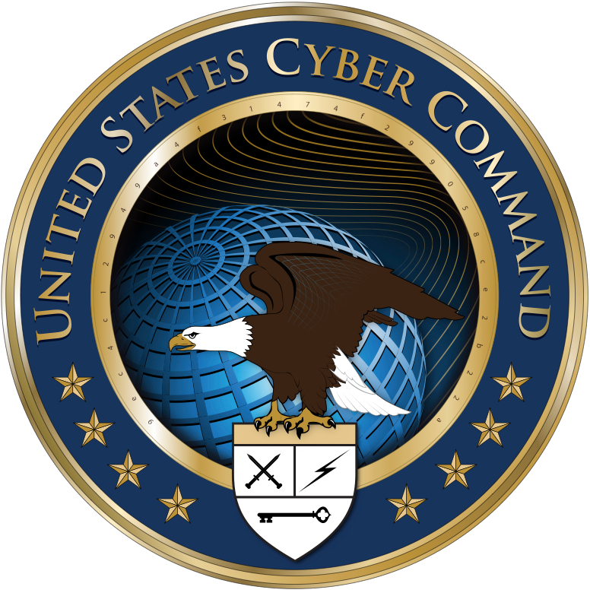
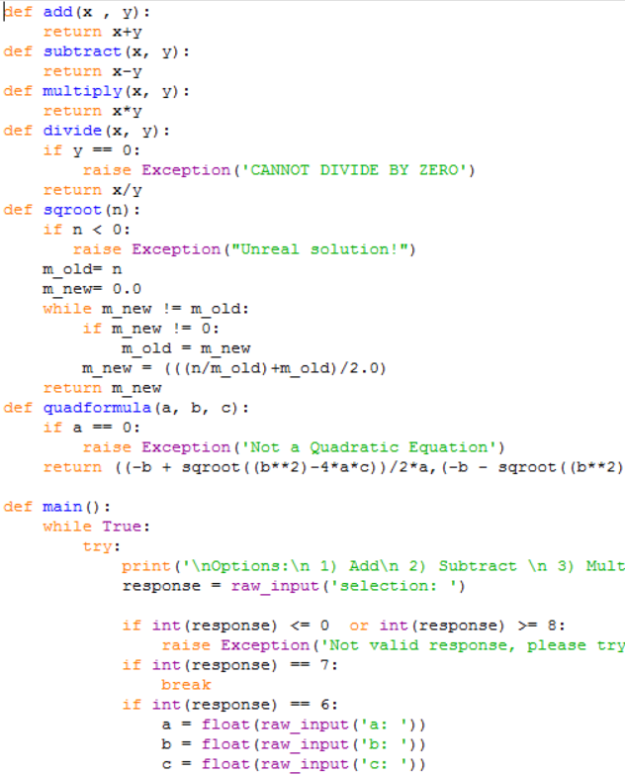
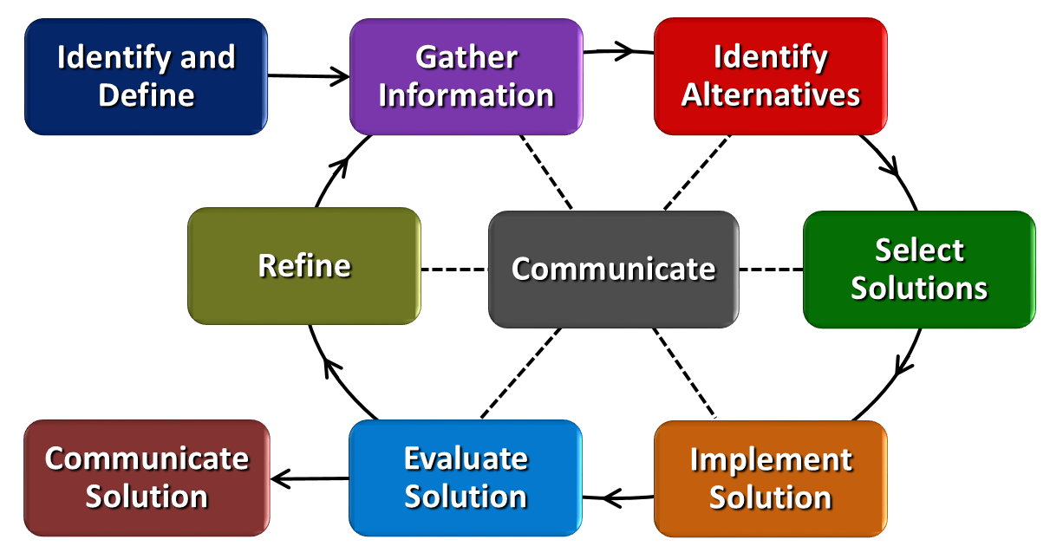
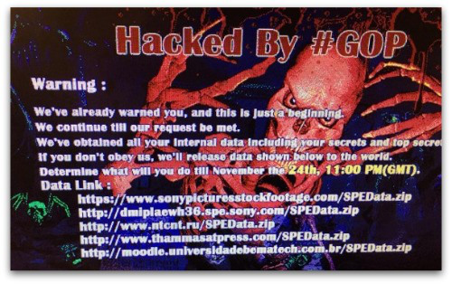
Cybersecurity Samuel Mizener Kings High School, Computer Science, 9th
RET is funded by the National Science Foundation, grant # EEC-1404766
The world of
Cybersecurity
Are you writing
safe programs?
Where is society
vulnerable to
cyberspace attacks?
Hackers OVERTAKE Jeep vehicles remotely – Causes major recall
Writing codes that do
ONLY what you want and
nothing more.
https://en.wikipedia.org/wiki/List_of_federal_agencies_in_the_United_States
Who is keeping you safe??
http://www.zeroto60times.com/large-car-logos-2/large-jeep-truck-logo/
Customer information STOLEN!
Credit Card #’s
Social Security #’s
Personal Information
http://www.bluekaizen.org/stuxnet-part1-the-perfect-crime/
Cyber Warfare is already part of modern military efforts.
Heartbleed CRIPPLES multiple companies – Cost millions of dollars to fix.
Photohttp://www.newsplex.com/home/headlines/Federal-Investigators-Link-North-Korea-to-Sony-Hack-Attack-286167211.html: Reddit
Photo: Reddit
Can the Engineering Design Process (above) be used to reduce vulnerabilities in code?
Sony Entertainment:
Hacked by North Korea
Retaliation for “Interview”
Resulted in sanctions
Images in this column courtesy of http://www.brandsoftheworld.com/

